Slide 1
5. 视觉词袋模型 Bag of Visual Words
罗志明
zhiming.luo@xmu.edu.cn

Slide 2
提纲
简介
视觉词袋模型
改进的视觉词袋模型
图像检索

Slide 3
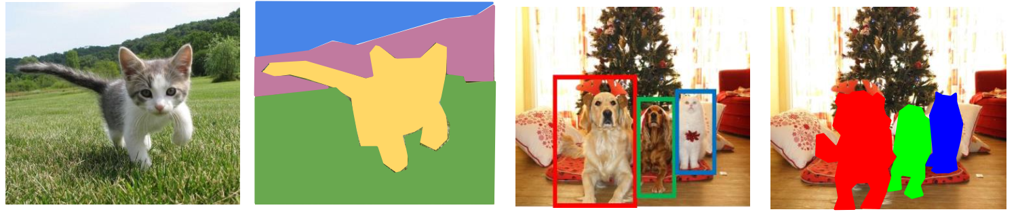
经典的视觉识别任务
图像分类
语义分割
目标检测
实例分割

Slide 4
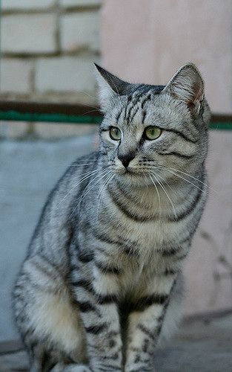
图像分类
计算视觉视觉的主要任务之一
Cat

Slide 5
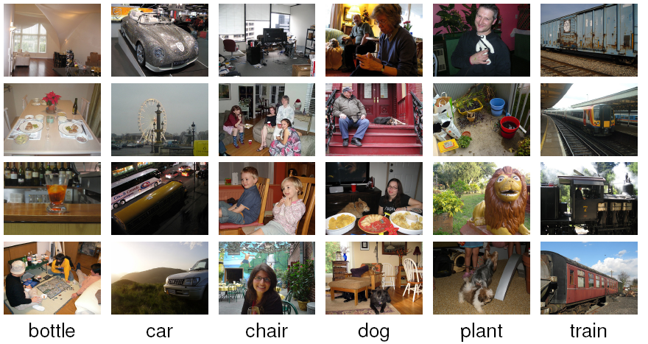
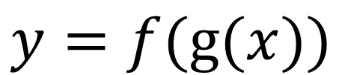
图像分类
数据驱动的方法：构建机器学习模型
Classifier
Feature Encoder
$$y=f(g(x))$$
Prediction
Image
The Pascal VOC challenge: a competition on image classification

Slide 6
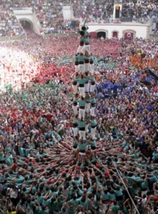
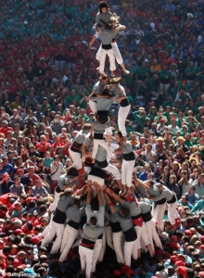
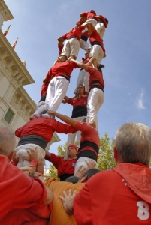
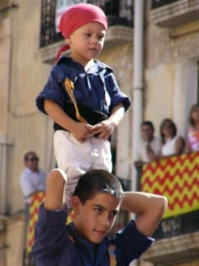
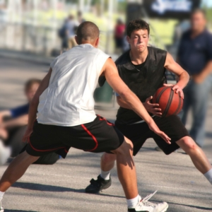
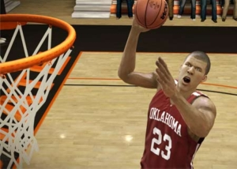
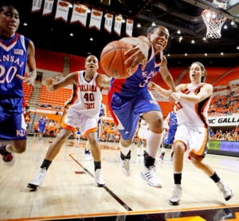
图像分类的难点
Variations in viewpoint and zoom.
Variations in pose.

Slide 7
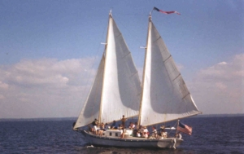
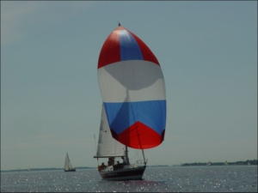
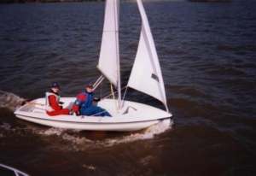
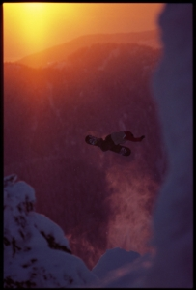
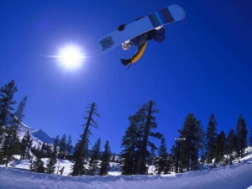
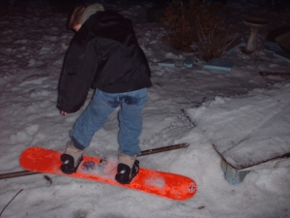
图像分类的难点
Intra-class variation.
Lighting changes.

Slide 8
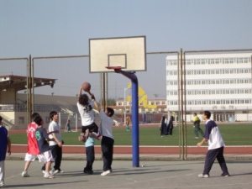
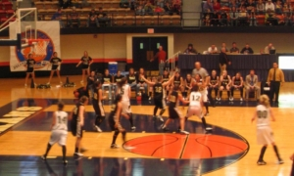
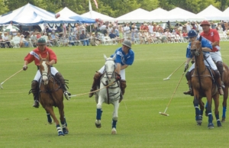
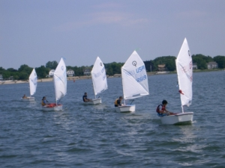
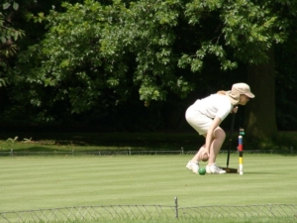
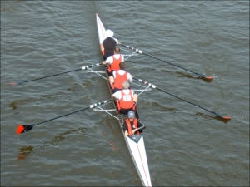
图像分类的难点
Background variation.
Similar backgrounds- Different classes.

Slide 9
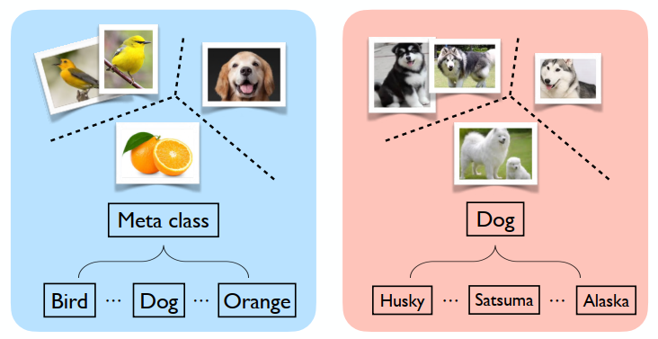
图像分类
细粒度图像分类

Slide 10
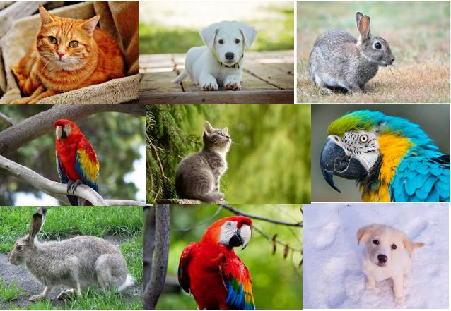
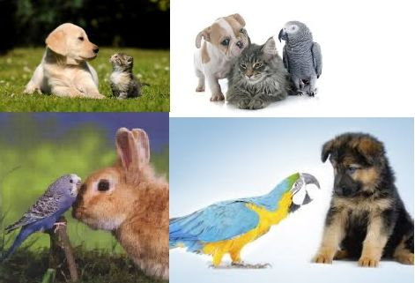
图像分类
多标签图像分类

Slide 11
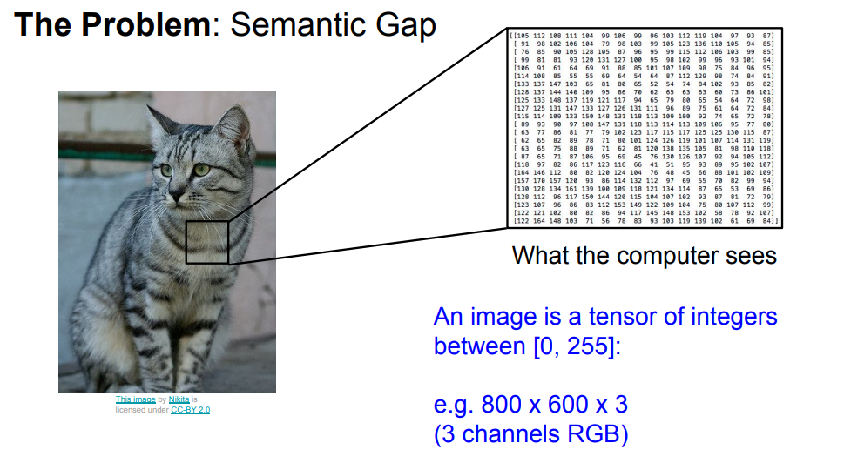
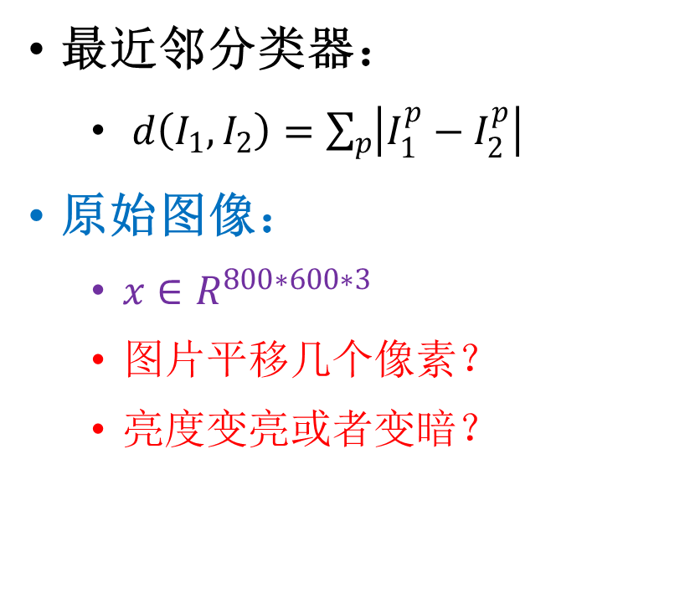
图像特征表示
最近邻分类器：
$d\left(I_{1},I_{2}\right)=\sum_{p}{\left|I_{1}^{p}−I_{2}^{p}\right|}$
原始图像：
$x∈R^{800∗600∗3}$
图片平移几个像素？
亮度变亮或者变暗？

Slide 12
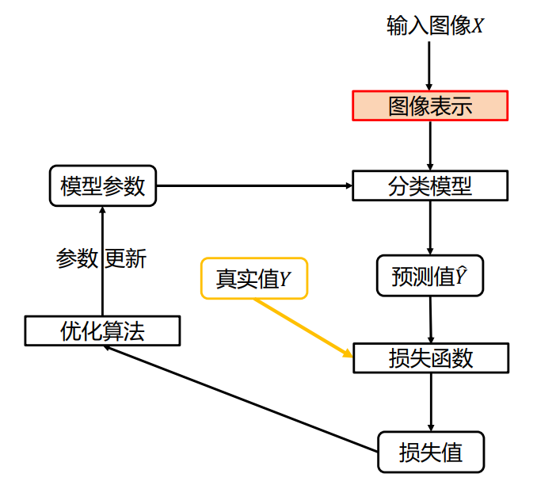
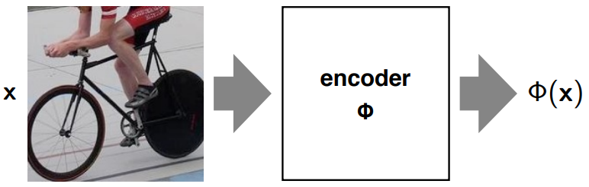
图像特征表示
将图像编码成一个特征向量

Slide 13
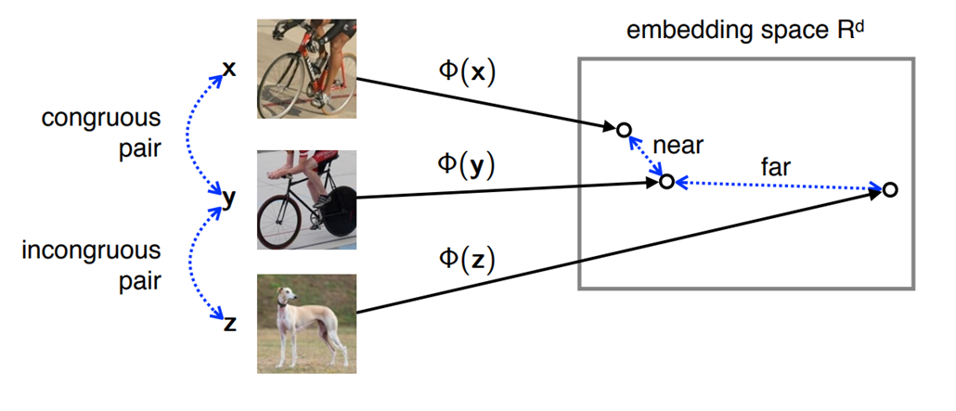
好的特征表示
Powerful: meaningful similarity / untangles factors
Cheap: fast to evaluation (can be computed on the fly)
Compact: small code (takes little RAM, disk, IO)

Slide 14
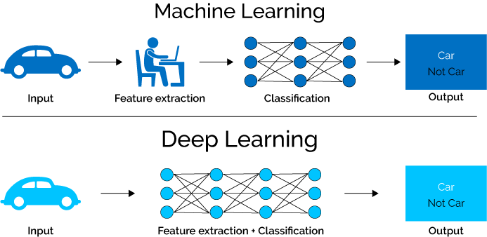
如何得到好的特征表示？

Slide 15
提纲
简介
视觉词袋模型
改进的视觉词袋模型

Slide 16
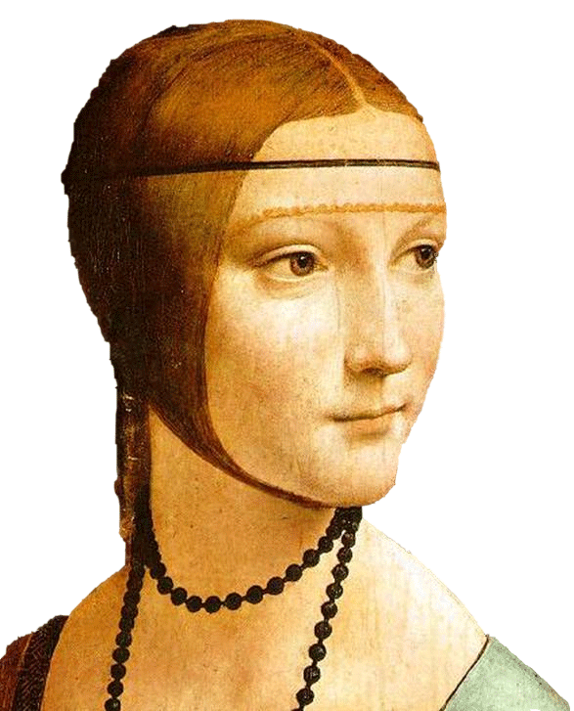
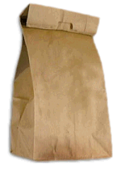
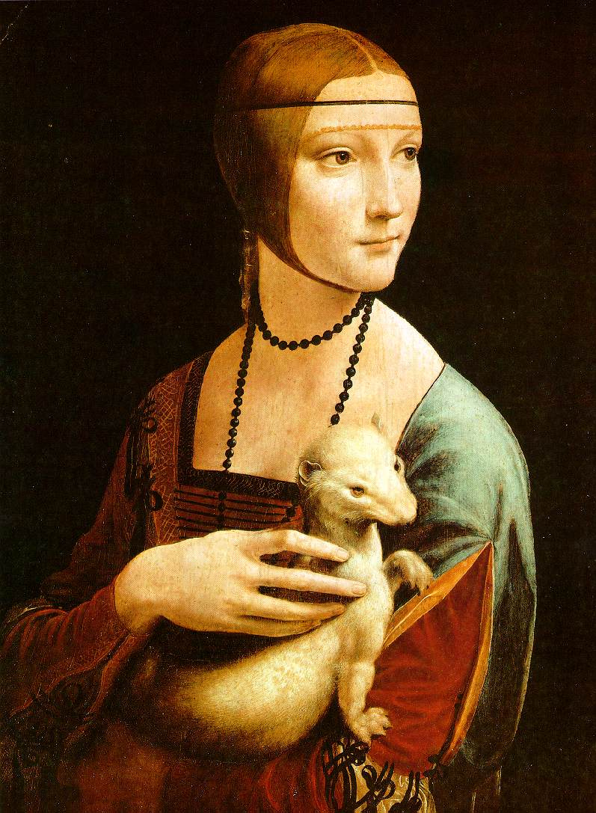
Bag-of-Visual-Words
Object
Bag of ‘words’

Slide 17
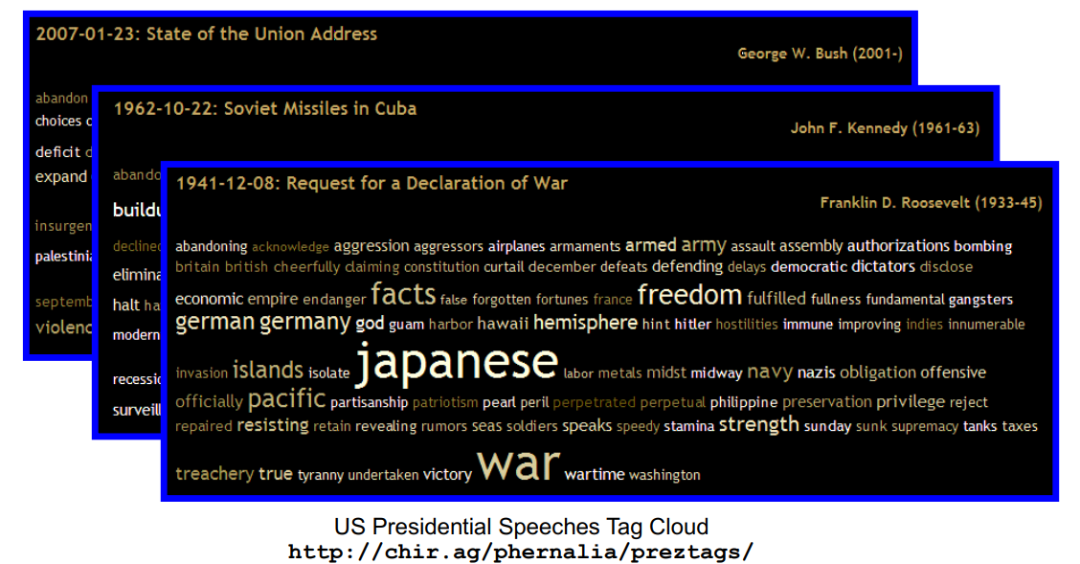
Intuition 1: Bag-of-words models
Orderless document representation: frequencies of words from a dictionary

Slide 18
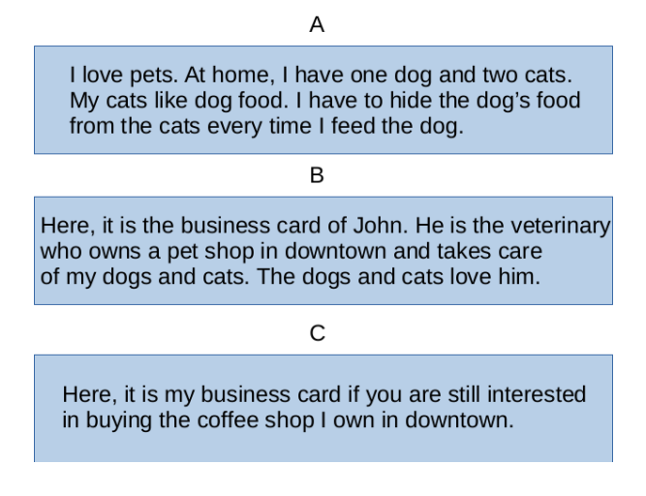
Intuition 1: Bag-of-words models
Let A, B, and C be examples of texts about different subjects.
A Bag of Words (BoW) is a dictionary of keywords identified as the most frequent ones in texts from different subjects.

Slide 19
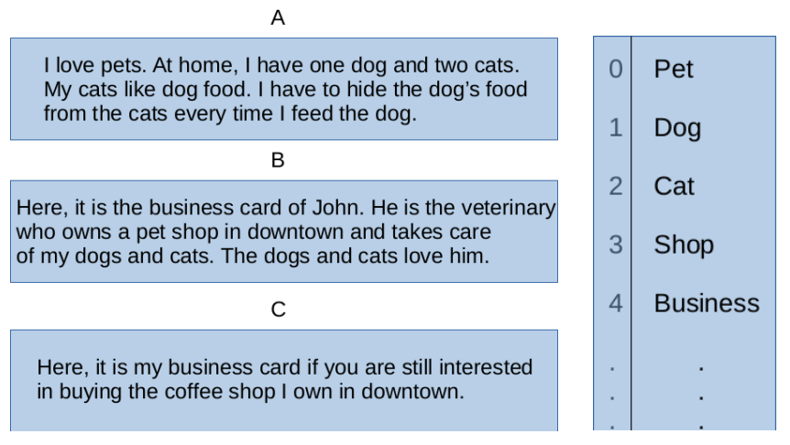
Intuition 1: Bag-of-words models
Let A, B, and C be examples of texts about different subjects.
By using the dictionary on the right to determine the frequency of its words in A, B, and C, each text is represented by the following histograms.

Slide 20
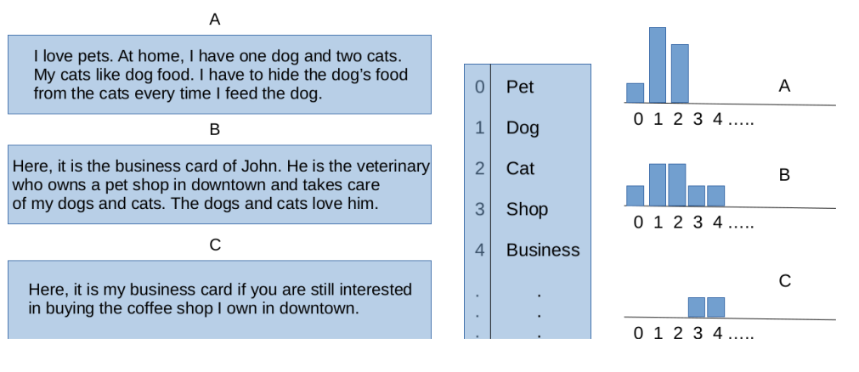
Intuition 1: Bag-of-words models
We expect higher similarity between the histograms of A and B then between any of them and the histogram of C.

Slide 21
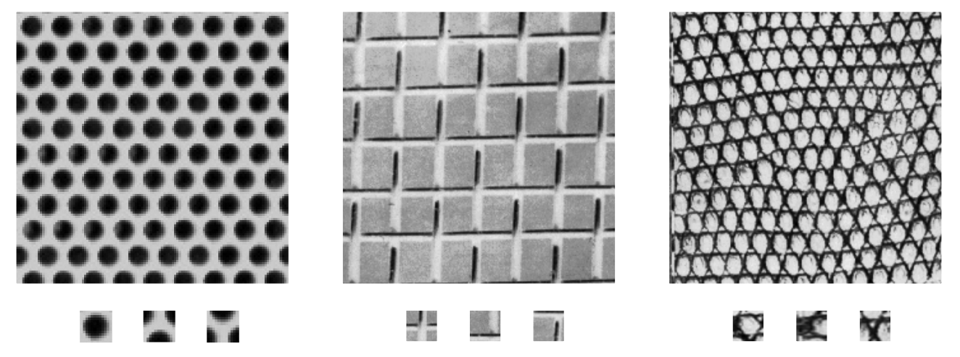
Intuition 2: Texture recognition
Texture is characterized by the repetition of basic elements or textons

Slide 22
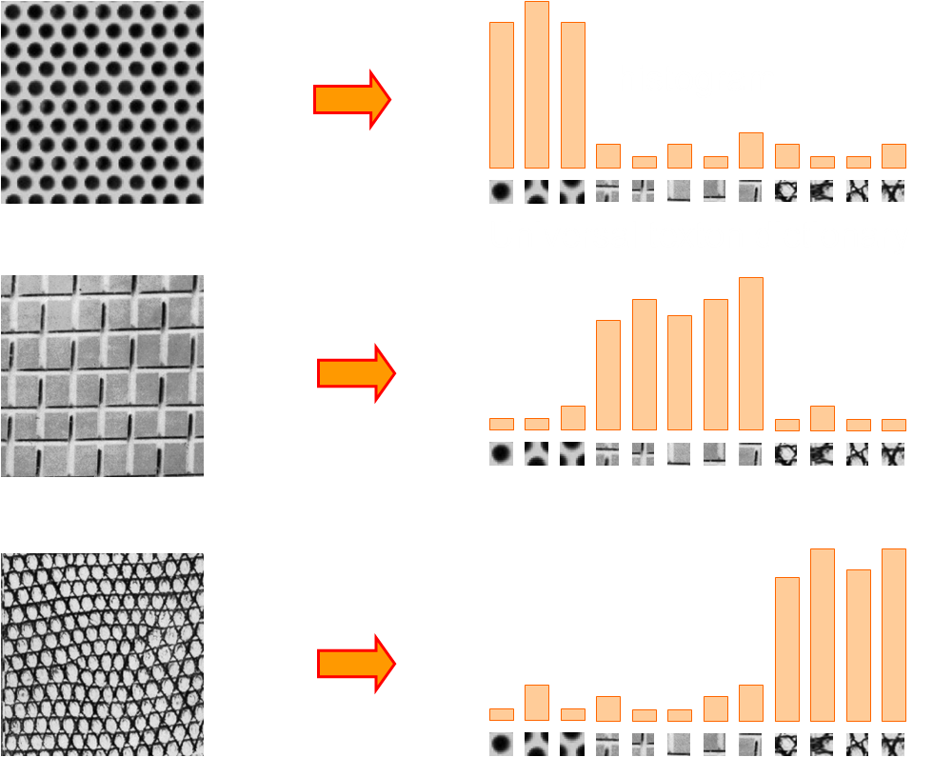
Intuition 2: Texture recognition

Slide 23
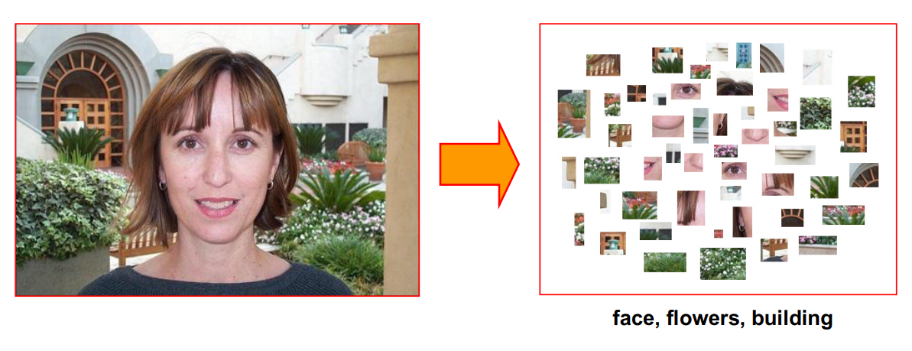
BOVW for object recognition
Works pretty well for image-level classification and for recognizing object instances.

Slide 24
BOVW for object recognition
How to transfer the image patches into visual word?

Slide 25
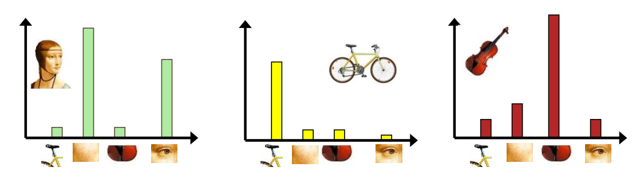
步骤（Procedure）
提取局部特征（Extract local descriptor）
学习视觉词典 （Learn “visual vocabular” ）
codebook generation
生成图像特征（Image representation）
coding, vector quantization

Slide 26
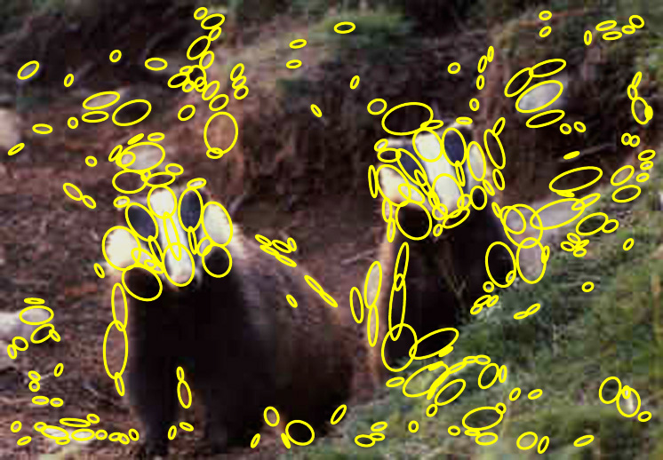
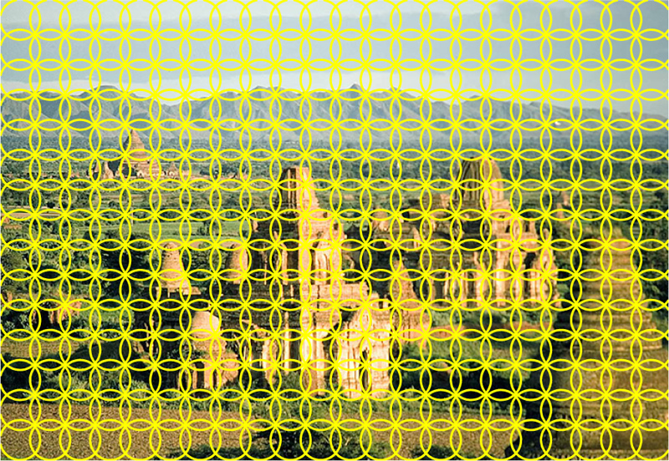
1. 提取局部特征(Extract local descriptor)
特征点(Interest regions) 或 密集采样(Dense sampling)

Slide 27
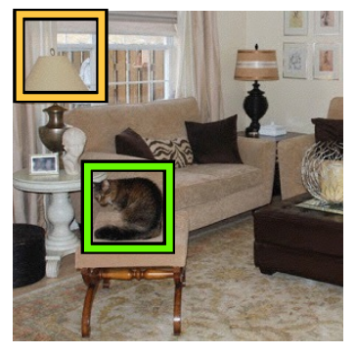
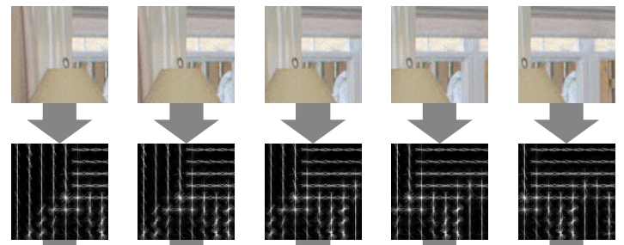
1. Extract local descriptor
计算每一个局部块的SIFT、LBP或者其他局部特征

Slide 28
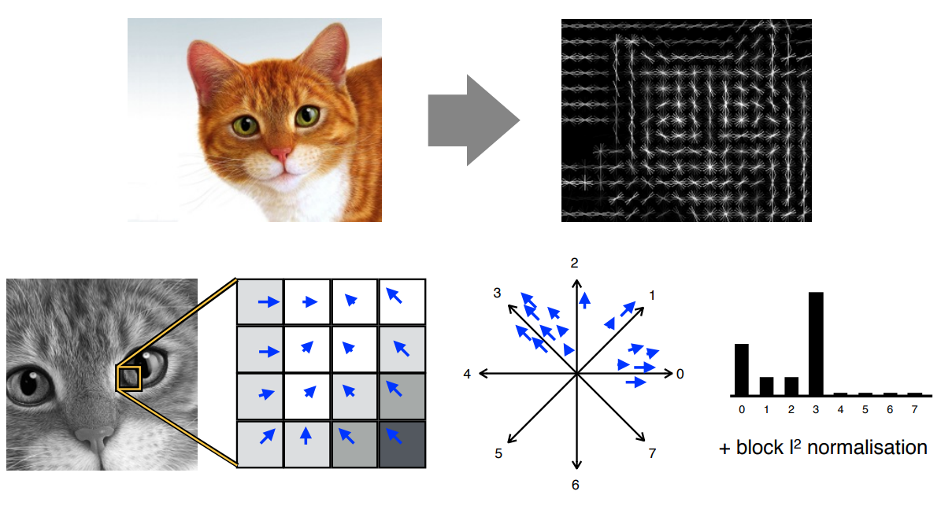
1. Extract local descriptor
SIFT 或 HOG

Slide 29
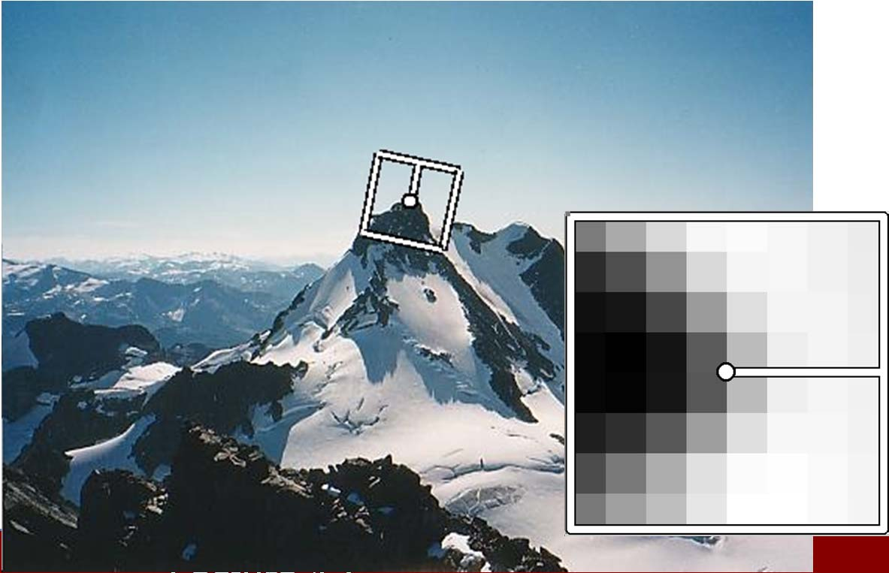
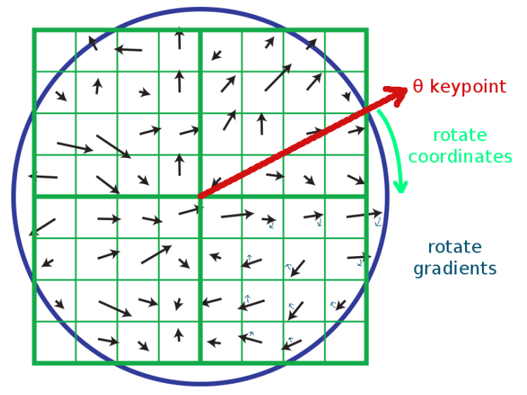

1. Extract local descriptor
SIFT Descriptor
根据主方向将梯度和位置进行旋转
将16*16的图像块划分成4*4的区域
对每一个区域计算8个方向的直方图
L2归一化
特征维度：$4∗4∗8=128$

Slide 30


2.学习视觉词典 （Learn “visual vocabular” ）

Slide 31


2. Learn “Visual vocabulary”

Slide 32


2. Learn “Visual vocabulary”

Slide 33

2. Learn “Visual vocabulary”
K-Means聚类

Slide 34

2. Learn “Visual vocabulary”
K-Means聚类

Slide 35

2. Learn “Visual vocabulary”
K-Means聚类

Slide 36

2. Learn “Visual vocabulary”
K-Means聚类

Slide 37

2. Learn “Visual vocabulary”
K-means聚类
优化目标函数
算法流程:
随机初始化K个聚类中心
迭代直到收敛：
将每一个样本赋值为最近的聚类中心
重新计算聚类中心

Slide 38

2. Learn “visual vocabulary”
“视觉词典”示例

Slide 39

2. Learn “visual vocabulary”
“视觉词典”示例

Slide 40


2. Learn “visual vocabulary”
如何选择合适词典大小（vocabulary size)
太小: 词典的特征表达能力不够
太大: 特征表述稀疏、过拟合

Slide 41

3. 生成图像特征（Image Representation）

Slide 42

3. Image Representation

Slide 43



3. Image Representation
特征的使用
将图像的特征表示看成是一个特征向量，然后使用分类器进行分类 (KNN, SVM)
对图像集里面的特征向量进行聚类
发现里面的视觉主题
$$y=f(∅\left(x\right))$$
How do we learn a model for recognizing them?

Slide 44

小结

Slide 45
图像分类Classification
分类器
KNN
SVM
Category
decision

Slide 46

Nearest Neighbors Classifier

Slide 47

K-Nearest Neighbors Classifier

Slide 48

Functions for comparing histograms
L1 distance
$$D\left(h_{1},h_{2}\right)=\sum_{i=1}^{N}{\left|h_{1}\left(i\right)−h_{2}(i)\right|}$$
$χ^{2}$ distance
$$D\left(h_{1},h_{2}\right)=\sum_{i=1}^{N}{\frac{{\left(h_{1}\left(i\right)−h_{2}(i)\right)}^{2}}{h_{1}\left(i\right)+h_{2}(i)}}$$
Histogram intersection kernel
$$D\left(h_{1},h_{2}\right)=\sum_{i=1}^{N}{\min{(h_{1}\left(i\right), h_{2}(i))}}$$

Slide 49

SVM

Slide 50
提纲
简介
视觉词袋模型
改进的视觉词袋模型

Slide 51
改进的视觉词袋模型
Spatial Information
Soft Assignment
Vector of Locally aggregated descriptors (VLAD)
Fisher Vector (FV)

Slide 52

1. Spatial Information
Loss of spatial information

Slide 53






















Spatial pyramid representation
level 0
level 1
level 2
Lazebnik S, Schmid C, Ponce J. “Beyond bags of features: Spatial pyramid matching for recognizing natural scene categories”, CVPR 2006

Slide 54

Spatial pyramid histograms

Slide 55















Caltech-101 dataset
Multi-class classification results (30 training images per class)
http://www.vision.caltech.edu/Image_Datasets/Caltech101/Caltech101.html

Slide 56


Spatially-augmented descriptors
Alternative to spatial pyramid
Greatly reduced dimensionality

Slide 57
2. Soft Assignments
Kernel Codebooks
Locality-constrained Linear Coding (LLC)

Slide 58




Kernel Codebooks
Jan C. van Gemert, et al. “Kernel Codebooks for Scene Categorization.” ECCV 2008

Slide 59



Locality-constrained Linear Coding (LLC)
Wang J, et al.. “Locality-constrained Linear Coding for Image Classification.” CVPR 2010

Slide 60

3. Vector of Locally Aggregated Descriptors (VLAD)
Feature dimension: KD
Jégou H, Douze M, Schmid C, Pérez P. “Aggregating local descriptors into a compact image representation.” CVPR 2010

Slide 61

3. VLAD

Slide 62


4. Fisher Vector
Sanchez J, et al. “Image Classification with the Fisher Vector: Theory and Practice.” IJCV 2013

Slide 63

Evaluation of different encoding methods
Chatfield K, Lempitsky V, Vedaldi A, Zisserman A. “The devil is in the details: an evaluation of recent feature encoding methods.” BMVC 2011.

Slide 64
Resource
Slides
http://www.robots.ox.ac.uk/~vedaldi/assets/teach/vedaldi14bmvc-tutorial.pdf
http://cs.brown.edu/courses/cs143/lectures/2020Spring_11_RecognitionAndBagOfWords.pptx
http://vision.stanford.edu/teaching/cs131_fall1718/files/14_BoW_bayes.pdf
http://cat.cvc.uab.es/~joost/data/master/project_slides.ppt
Code
https://www.vlfeat.org/applications/apps.html
https://www.robots.ox.ac.uk/~vgg/practicals/instance-recognition/index.html
https://sites.google.com/site/vggpracticals/category-level-recognition
http://cat.cvc.uab.es/~joost/software.html

